Slide 1
Get PrEPped: Expanding the Role of Pharmacists in HIV Prevention
Anne M. Masich, PharmD, BCPS
Dayanjan S. Wijesinghe, PhD

Slide 2
Objectives
Discuss the importance and barriers to expanding access to human immunodeficiency virus (HIV) pre-exposure prophylaxis (PrEP)
Understand the Virginia HIV PrEP Statewide Protocol for Pharmacists
Review available HIV PrEP regimens
Apply HIV PrEP knowledge utilizing an artificial intelligence (AI)—powered conversational training platform

Slide 3
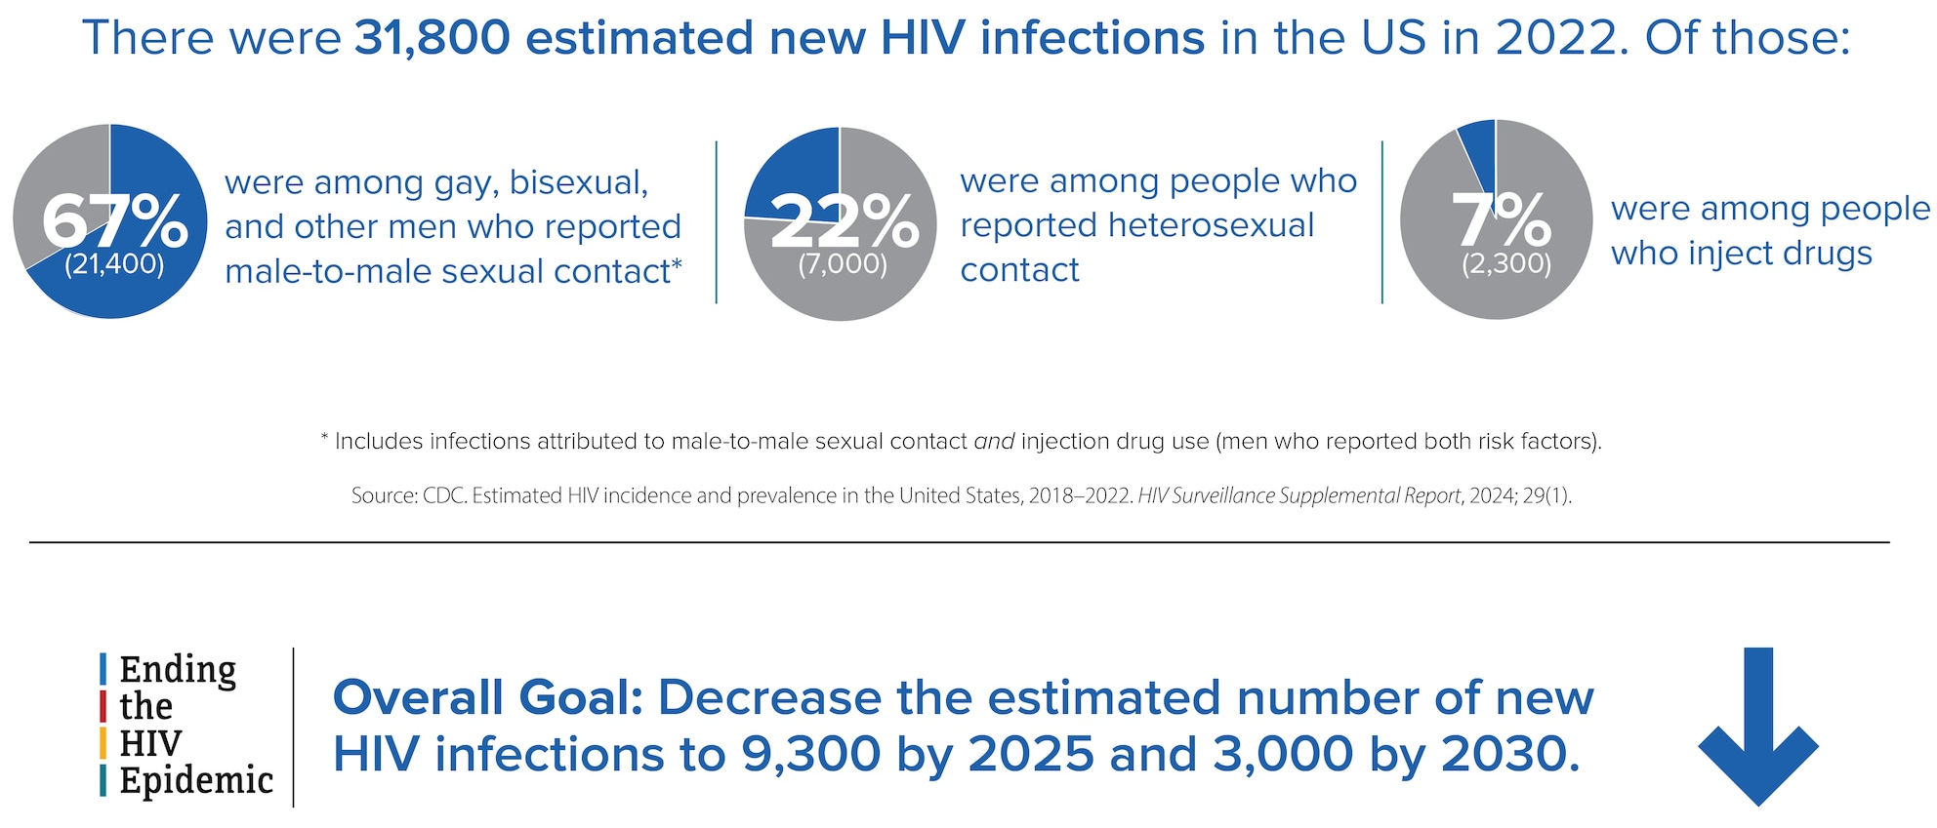
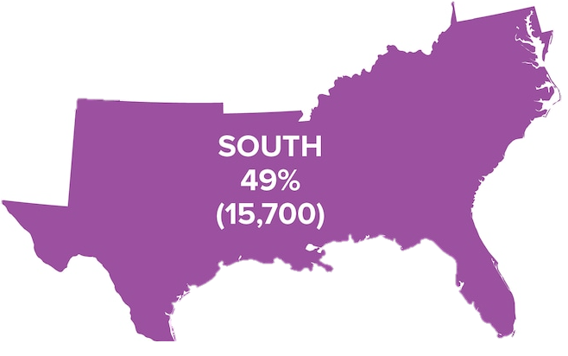
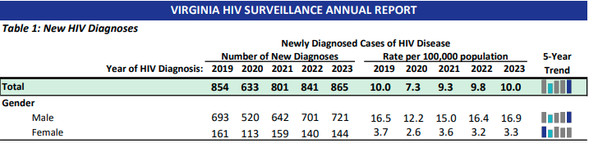
https://www.cdc.gov/hiv/data-research/facts-stats/index.html
https://www.vdh.virginia.gov/content/uploads/sites/10/2024/08/HIV-AIDS-Annual-Report-2023.pdf
Notes:
It is estimated that ~15% of people are HIV(+) and do not know their status. Of people with diagnosed HIV, 65% were virally suppress in 2022.

Slide 4
Approaches to HIV Prevention
HIV-negative Person |  |  | HIV-positive Person
Behavior Risk Reduction | Pre-Exposure Prophylaxis (PrEP) >99% Effective | Postexposure Prophylaxis (PEP) | Treatment as Prevention Undetectable = Untransmittable
Behavioral risk reduction, ongoing support and outreach occurs throughout the continuum
Behavior Risk Reduction: understanding risk, condom use, male circumcision, testing and treatment of sexual transmitted infections (STIs), use of clean needles/syringes
Notes:
~65% are virally suppressed

Slide 5
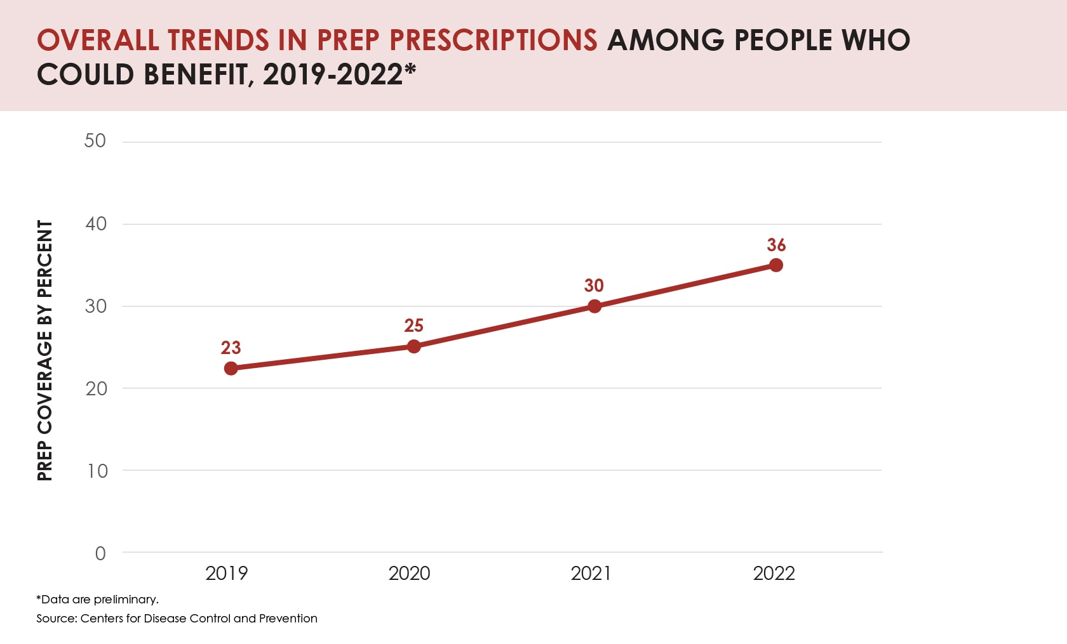
Barriers to PrEP
Knowledge/awareness of PrEP
Perception of HIV risk
Social stigma
Provider bias
Distrust of healthcare providers and healthcare systems
Lack of access to medical care
Lack of access/awareness of financial assistance options
Side effect concerns
VA = 20%
VA = 7.5%
https://www.cdc.gov/nchhstp/director-letters/expanding-prep-coverage.html
Mayer KH, 2020
Notes:
Overall increase in PrEP since announcement of Ending the HIV Epidemic in the U.S. (EHE) initiative. 1.2 million Americans could benefit from PrEP.

Slide 6
The Power of Pharmacy-Based HIV Prevention
Accessibility
Trusted Professionals
90% of Americans live within 5 miles of a pharmacy, making them ideal for HIV prevention services.
Pharmacists are among the most trusted healthcare professionals, deeply embedded in communities.
Extended Hours
Less Stigmatized
Pharmacies offer convenient locations and extended hours compared to traditional clinics.
Pharmacies provide a less stigmatized environment for accessing HIV prevention services.

Slide 7
Virginia Pharmacist HIV PrEP Statewide Protocol

Slide 8
Protocol Overview
Approved in 2021; Last revised 2024
Pharmacist completion of a comprehensive training program related to the prescribing/dispensing of HIV PrEP medications, including related trauma-informed care
PrEP Self-screening Patient Intake Form
  Demographic information, insurance, provider name/contact
  PrEP indication and eligibility
  HIV testing, PrEP and PEP history, acute HIV symptom review
  Brief medical history
  Testing and Treatment requirement acknowledgement
Assessment and Treatment Care Pathways
PrEP prescription and provider notification examples
Communication examples
Protocol exclusions: <18 years, history of HIV, HIV test reactive/indeterminate, acute symptoms, hepatitis B, kidney or bone disease if not a candidate for FTC/TAF or CAB
https://www.dhp.virginia.gov/media/dhpweb/docs/pharmacy/protocols/PrEPCombinedProtocol.pdf
Notes:
Communication examples include HIV reactive/positive/indeterminate results, concerns for acute HIV infection, reactive/positive/indeterminate results for STIs

Slide 9
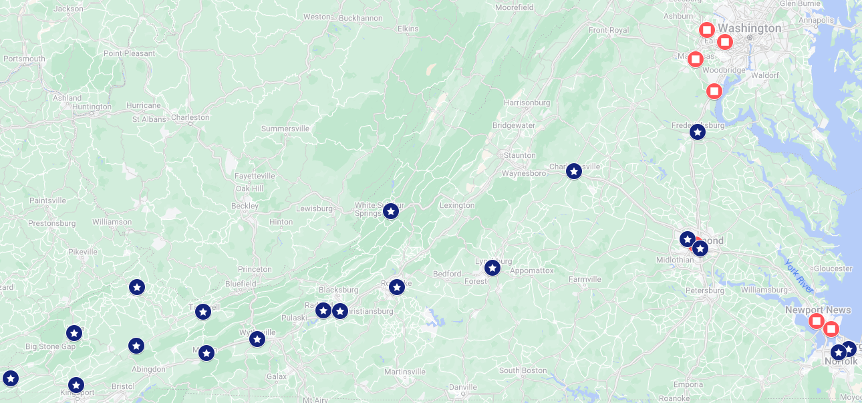
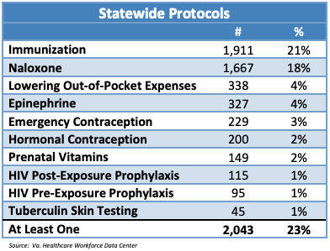
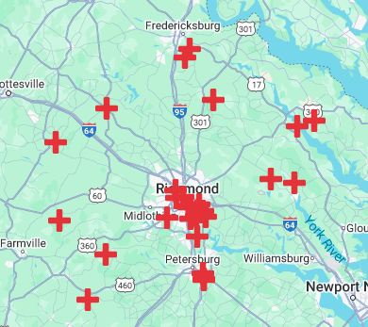
Implementation of HIV PrEP Protocol
PrEP access in Virginia
https://www.dhp.virginia.gov/media/dhpweb/docs/hwdc/pharm/0202Pharm2023.pdf
Notes:
Barriers for protocol implementation in Virginia is unclear, but likely related to reported barriers in other states

Slide 10
Barriers to Implementation
Pharmacist hesitancy due to confidence in knowledge, experience, liability concerns or personal beliefs
Need for additional training
Cost to the pharmacy
Lack of public awareness
Logistical challenges
  Availability of a private counseling area
  Laboratory testing and medical record sharing
  Lack of time and staffing
  Workflow adjustments
https://www.vdh.virginia.gov
https://preplocator.org/
Notes:
Barriers for protocol implementation in Virginia is unclear, but likely related to reported barriers in other states

Slide 11
HIV PrEP Pharmacotherapy Review
Oral tablets
Long-acting injectable

Slide 12

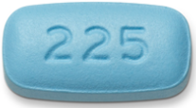
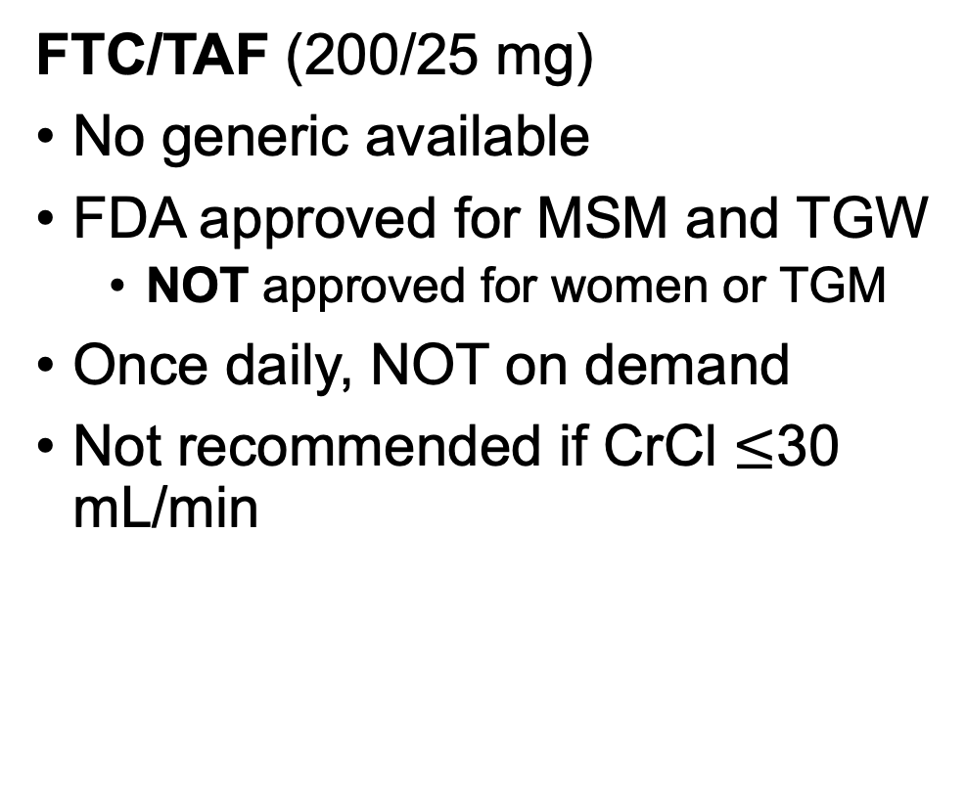
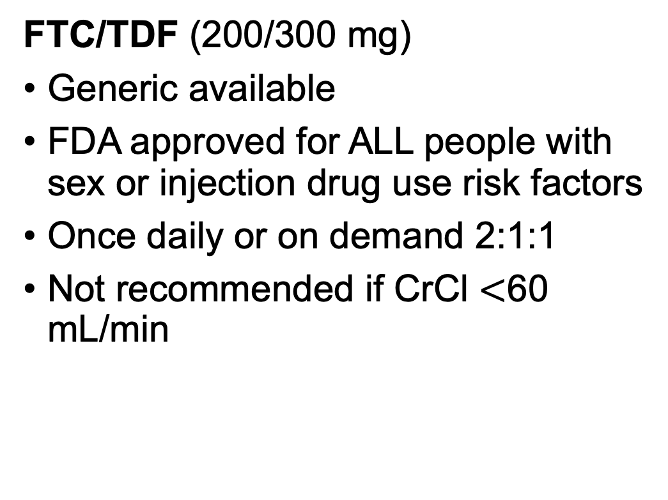
Oral PrEP Regimens
(nucleoside reverse transcriptase inhibitors)
FTC/TDF (200/300 mg)
Generic available
FDA approved for ALL people with sex or injection drug use risk factors
Once daily or on demand 2:1:1
Not recommended if CrCl $<$60 mL/min
FTC/TAF (200/25 mg)
No generic available
FDA approved for MSM and TGW
  NOT approved for women or TGM
Once daily, NOT on demand
Not recommended if CrCl $≤$30 mL/min
Adverse effects (FTC/TDF and FTC/TAF): nausea, GI upset, headache
Truvada (emtricitabine and tenofovir disoproxil fumarate) [package insert]. Gilead Sciences; 2024
Descovy (emtricitabine and tenofovir alafenamide) [Package Insert]. Gilead Sciences; 2022
FTC: emtricitabine; TDF: tenofovir disoproxil fumarate; CrCl: creatinine clearance mL/min; TAF: tenofovir alafenamide; MSM: men who have sex with men; TGW: transgender women; TGM: transgender men
Notes:
On demand dosing is off label and not recommend by the CDC. May be considered for cisgender males of any sexual orientation who have sex infrequently. Dosing: 2-24 hours prior to sexual activity, 1 tablet every 24 hours x2 2 tablets

Slide 13
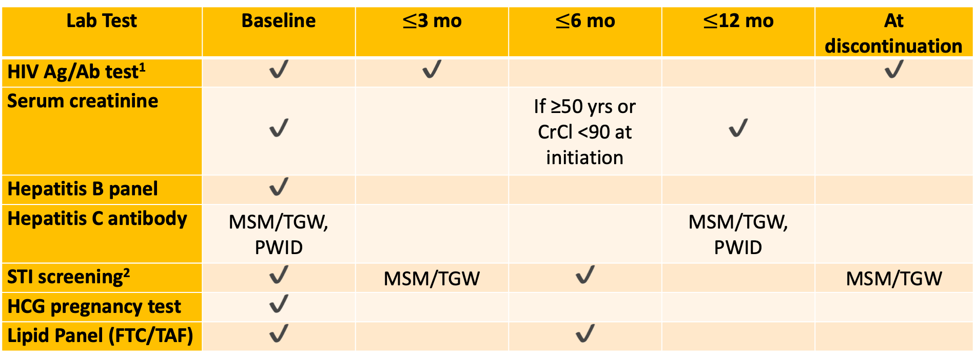
Oral PrEP Regimens
Monitoring Requirements
Lab Test | Baseline | $≤$3 mo | $≤$6 mo | $≤$12 mo | At discontinuation
HIV Ag/Ab test¹ | ✔️ | ✔️ |  |  | ✔️
Serum creatinine | ✔️ |  | If ≥50 yrs or CrCl <90 at initiation | ✔️
Hepatitis B panel | ✔️
Hepatitis C antibody | MSM/TGW, PWID |  |  | MSM/TGW, PWID
STI screening² | ✔️ | MSM/TGW | ✔️ |  | MSM/TGW
HCG pregnancy test | ✔️
Lipid Panel (FTC/TAF) | ✔️ |  | ✔️
¹HIV RNA is highly recommended, especially if symptoms of possible acute HIV develop. It is not a required test and should not be a barrier to prescribing PrEP.
²Chlamydia, gonorrhea, and syphilis
https://www.cdc.gov/hivnexus/hcp/prep/index.html
MSM: men who have sex with men; TGW: transgender women; PWID: person who injects drugs; CrCl: creatinine clearance mL/min

Slide 14
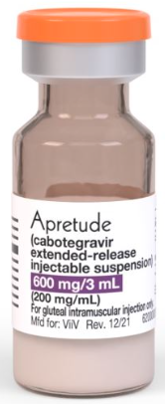
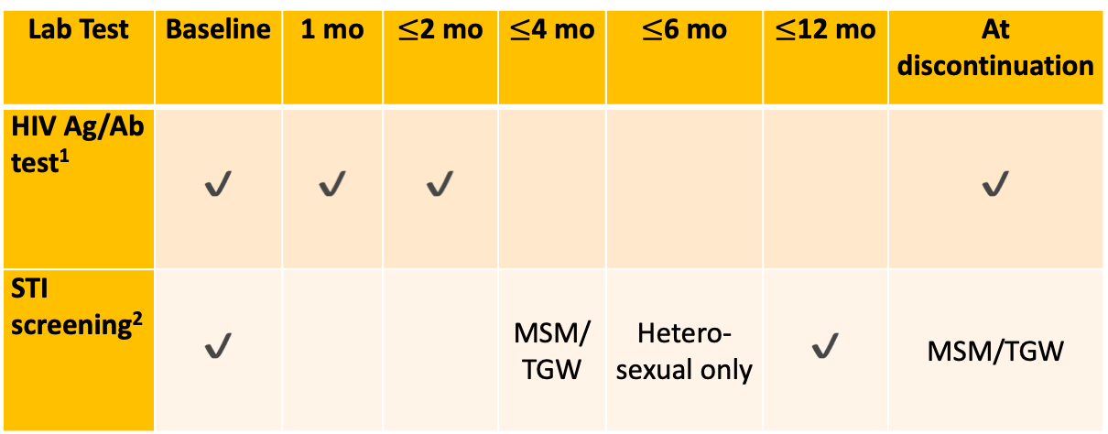
Long-acting Injectable
Integrase strand transfer inhibitor
Cabotegravir (300 mg)
FDA approved for ALL people with risk factors for sexual transmission
  NOT approved for PWID
Gluteal IM injection every 2 months (maintenance dose)
No renal adjustments
Injection site reactions
Monitoring requirements:
Lab Test | Baseline | 1 mo | $≤$2 mo | $≤$4 mo | $≤$6 mo | $≤$12 mo | At discontinuation
HIV Ag/Ab test¹ | ✔️ | ✔️ | ✔️ |  |  |  | ✔️
STI screening² | ✔️ |  |  | MSM/TGW | Hetero-sexual only | ✔️ | MSM/TGW
MSM: men who have sex with men; TGW: transgender women; PWID: person who injects drugs; CrCl: creatinine clearance mL/min
¹HIV RNA is highly recommended, especially if symptoms of possible acute HIV develop. It is not a required test and should not be a barrier to prescribing PrEP.
²Chlamydia, gonorrhea, and syphilis
Apretude (cabotegravir extended-release injectable suspension) [package insert]; ViiV Healthcare, 2024
https://www.cdc.gov/hivnexus/hcp/prep/index.html
Notes:
Found to be superior to daily TDF/FTC among high-risk cisgender men and transgender women who have sex with men (2021).
May initiate with oral lead-in or proceed directly to injections

Slide 15
Long-acting Injectable (Coming Soon…)
Capsid inhibitor
Lenacapavir (927 mg)
Pending FDA approval for PrEP
  PURPOSE 1 trial: 100% efficacy in adolescent girls and young women (Africa)
  PURPOSE 2 trial: 99.9% efficacy in cisgender men, transgender men/women and gender non-binary (international)
  Ongoing trials: women, cisgender women/men, transgender women/men, gender nonbinary who have sex with partners assigned male at birth and people who inject drugs
Abdominal subcutaneous injections (2 per dose) every 6 months
Adverse effects: injection site reactions and nausea
Sunlenca (lenacapavir) [package insert]. Gilead Sciences; 2024

Slide 16
Considerations When Choosing a PrEP Regimen
Patient preference
HIV risk behavior
Adherence
Renal function
Insurance or eligibility for patient/co-pay assistance programs

Slide 17
🤔 Check your knowledge
Which of the following is a barrier to expanding HIV PrEP access?
Provider and individual knowledge and awareness
Need for additional training
Logistical challenges within the community pharmacy
All of the above

Slide 18
🤔 Check your knowledge
Which of the following person is excluded from the Virginia Pharmacist PrEP prescribing protocol?
17-year-old who has multiple sexual partners
68-year-old with chronic kidney disease (CrCl=45 mL/min)
24-year-old who injects drugs
40-year-old with a history of sexually transmitted infections

Slide 19
🤔 Check your knowledge
Which of the following is TRUE regarding emtricitabine- tenofovir alafenamide (FTC/TAF)?
There is a generic form available
It is FDA approved for use in ALL persons at risk for HIV
It may be used for HIV PrEP in persons with reduce renal function as long as CrCl >30 mL/min
It may be taken “on demand”

Slide 20
🤔 Check your knowledge
Which of the following should be considered when determining the most appropriate HIV PrEP regimen for a person?
HIV risk factor/behavior
Cost
Patient preference (e.g. oral tablet vs. injection)
All of the above

Slide 21
Utilizing AI for Pharmacist HIV PrEP/PEP Training

Slide 22

AI-Based Training: A Promising Solution
Personalized Learning
Standardized Delivery
Improved Retention
AI-powered platforms deliver personalized learning experiences, adapting to individual learning styles and providing real-time feedback through interactive simulations.
Enables standardized training delivery while accommodating diverse needs of pharmacy staff across different practice settings.
Enhances knowledge retention, counseling skills, and confidence through scenario-based learning and immediate feedback.

Slide 23

VCU's Expertise in AI-Driven Training
1
Established Track Record
Developing and globally deploying AI-driven training tools for PharmD students.
2
PharmTutorAI.com
Self-contained applications with integrated feedback mechanisms, hosted on Amazon Web Services.
3
Increasing Recognition
Winner of the 2024 AACP Laboratory Innovation and Teaching Excellence (LITE) Award.
4
Global Reach
37 countries using deployed applications for PharmD education.

Slide 24
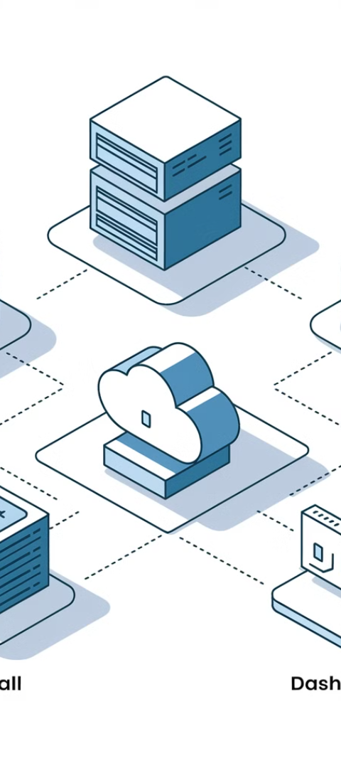




Development of AI-Enhanced PrEP/PEP Training Platform
Core Module Development
Create three comprehensive training modules on PrEP/PEP counseling
AI-Driven Patient Simulation
Integrate AI driven voice and SMS based conversational agents simulating a diverse group of patients.
Technical Architecture
Develop a three-tier architecture using React, Node.js, and AWS services for a robust, scalable platform.
Learning Objectives and Assessment
Implement comprehensive learning objectives and multi-modal assessment methods.

Slide 25

AI-Driven Patient Simulation Features
Adaptive Scenarios
High-Risk Simulations
AI adapts to user responses, reflecting varying patient personalities and health literacy levels.
Specific protocols for scenarios like serodiscordant couples and substance use disorders.
Context Management
Clinical Guideline Validation
AI maintains conversation coherence through strategic context management.
Real-time validation against clinical guidelines ensures accuracy and relevance.

Slide 26




Technical Architecture Overview
Frontend Tier
1
React components with Tailwind CSS for responsive interface
Middle Tier
2
Node.js server for API orchestration and user management
Backend Tier
3
AWS services for serverless computing and data storage
Security Measures
4
End-to-end encryption and regular penetration testing

Slide 27

Learning Objectives and Assessment
Knowledge Assessment
Clinical Skills Evaluation
Professional Competency
Pre/post testing, adaptive questioning, case-based scenarios, and regular knowledge checks with detailed feedback.
AI simulation interactions, protocol adherence measurement, decision-making assessment, and communication effectiveness scoring.
Cultural sensitivity metrics, patient education effectiveness, clinical documentation accuracy, and interprofessional collaboration skills.

Slide 28
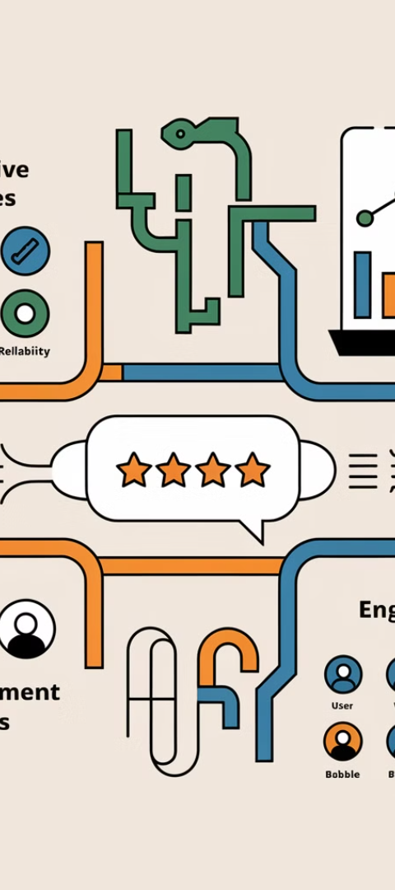
Comprehensive Evaluation Framework
Quantitative Measures
Qualitative Evaluation
System Usability Scale (SUS) scoring, targeting a minimum score of 70. Platform analytics tracking completion rates (target >80%), time-to-completion metrics, and error frequencies.
Think-aloud protocols during task completion, post-session debriefing interviews, and structured feedback surveys.
Performance Tracking
Custom analytics dashboard monitoring user engagement metrics, including time-on-task, completion rates, error patterns, and learning progression.

Slide 29
Pilot Implementation Study
Participant Recruitment
1
25 pharmacists from diverse settings
Platform Deployment
2
Secure, web-based interface on AWS
Training Integration
3
3-month implementation period
Data Collection
4
Mixed-methods approach

Slide 30
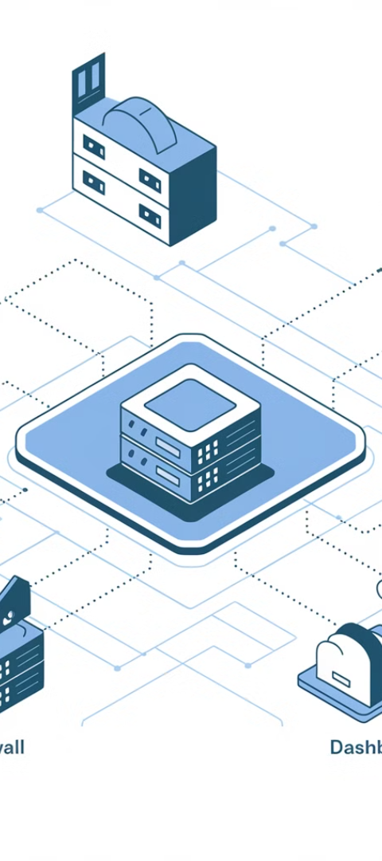




AWS-Based Platform Deployment
Hosting
Backend
Amazon S3 for static web hosting, CloudFront for content delivery
AWS Lambda for serverless computing, DynamoDB for NoSQL database
Security
Monitoring
AWS Cognito for authentication, API Gateway for secure routing
CloudWatch for real-time monitoring and alerting

Slide 31

Evaluation Metrics
Feasibility
Acceptability
Effectiveness
Completion rates (target >75%), technical performance, and workflow integration.
User satisfaction ratings (target >4 out of 5) and qualitative feedback from interviews and focus groups.
Pre- and post-training knowledge assessments, self-efficacy scores, and clinical decision-making capability through scenario-based assessments.

Slide 32

Potential Challenges and Solutions
Technical Challenges
Implementation Challenges
Implement automated cloud-based backups
Design self-paced, on-demand modules
Develop regular update and maintenance protocols
Create concise, modular content to minimize workflow disruption
Establish 24/7 helpdesk support system
Offer post-training support and quick-reference guides

Slide 33

Expected Outcomes
Immediate Deliverables
Long-term Impact
Validated AI training platform, implementation blueprint, and preliminary effectiveness data.
Expanded HIV prevention services, enhanced pharmacist capabilities, and a scalable training model.
Global Reach
Multilingual capabilities for training content and patient simulations, ensuring accessibility worldwide.

Slide 34

Let’s Chat with a Patient
https://hivcounseltrainer-1-mqbhzw3ysa-uc.a.run.app/

